Slide 1

what is " Rstudio "
RStudio is a open-source integrated development environment (IDE) for R, a programming language for statistical computing and graphics.
https://en.wikipedia.org/wiki/RStudio

Slide 2
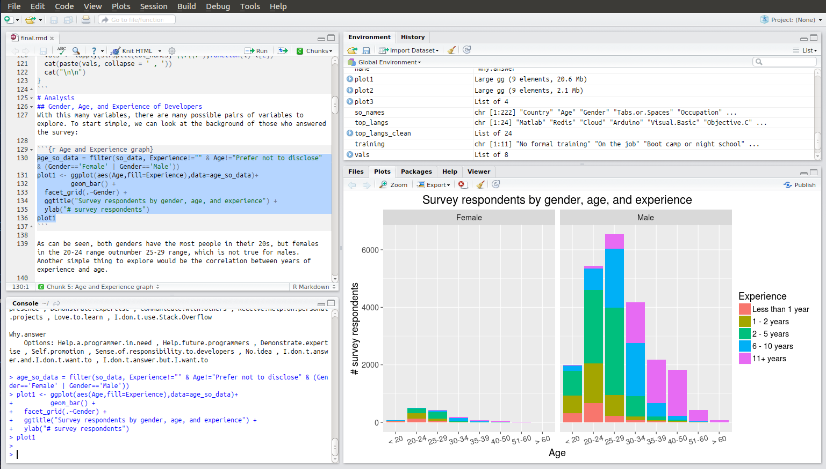
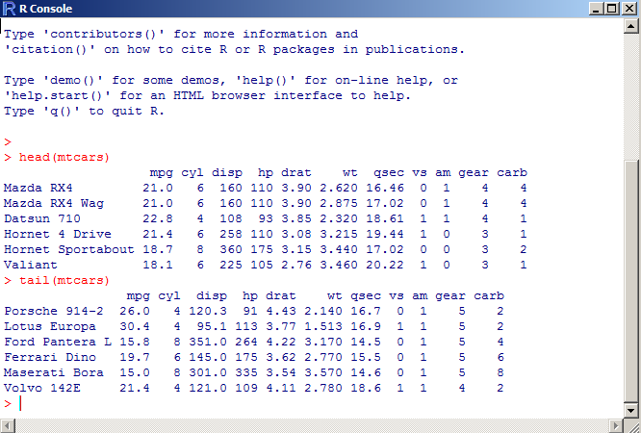
Purpose - Rstudio
Analyzing all Data

Slide 3
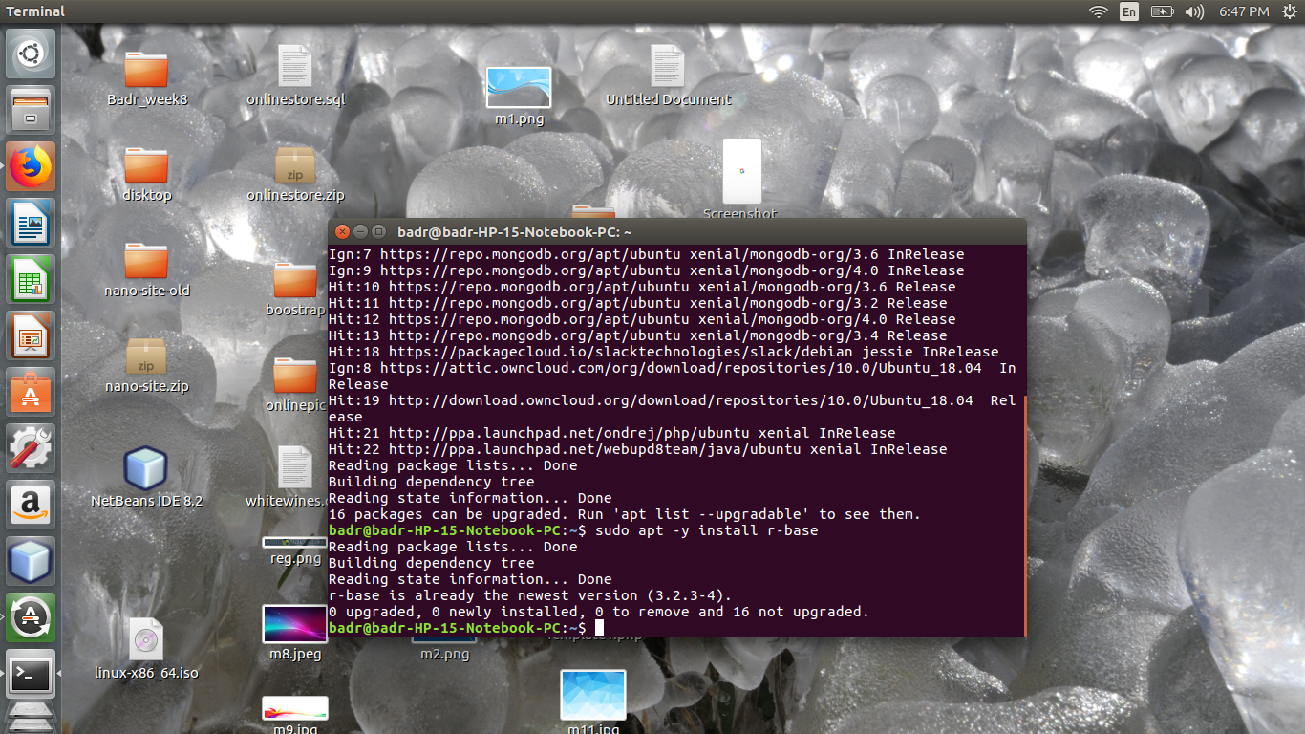
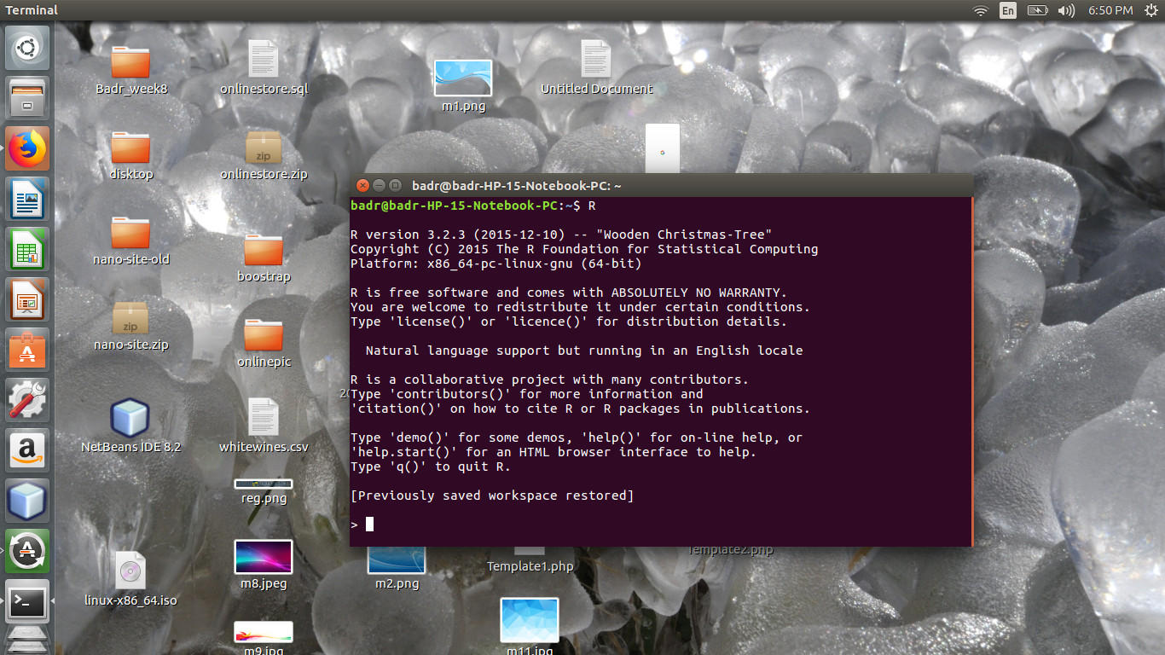
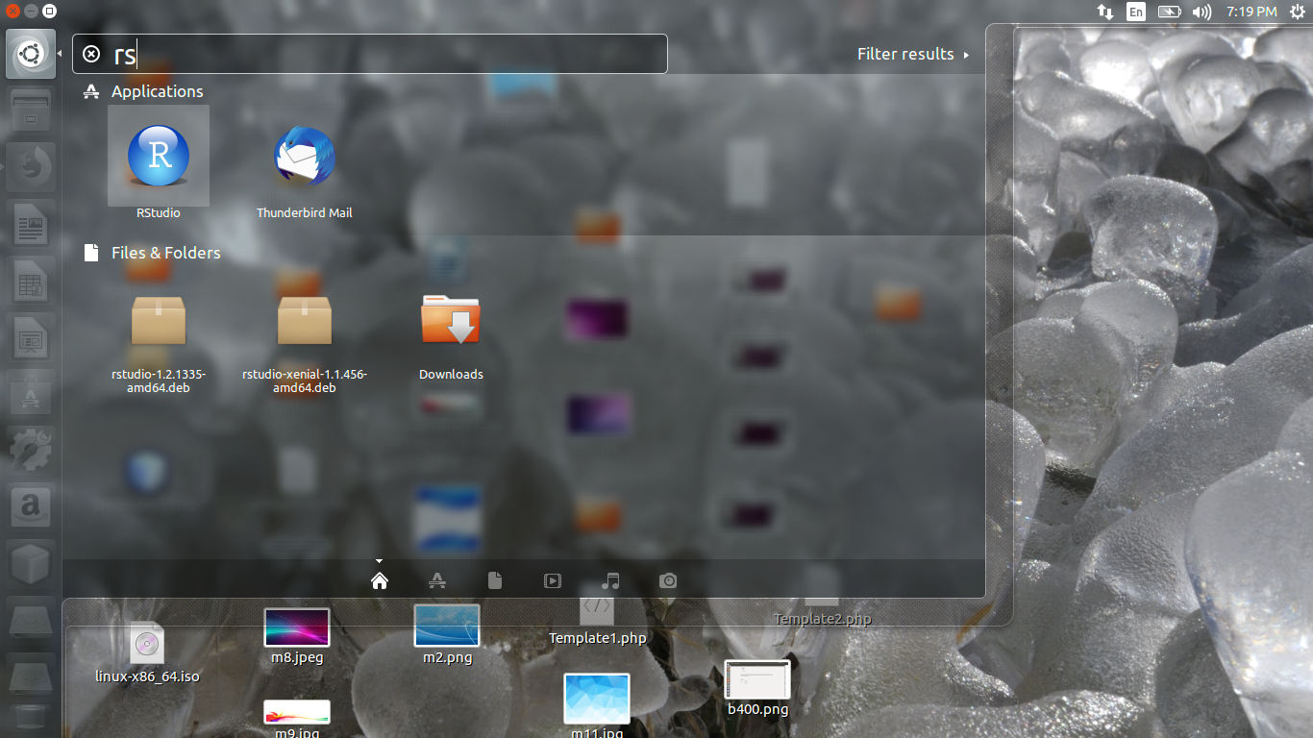
Install Rstudio ubuntu 18.04
Install ( R )
Sudo apt-get update
Sudo apt -y install r-base
Install (Rstudio )
(download and Install )
- https://www.rstudio.com/products/rstudio/download/#download

Slide 4
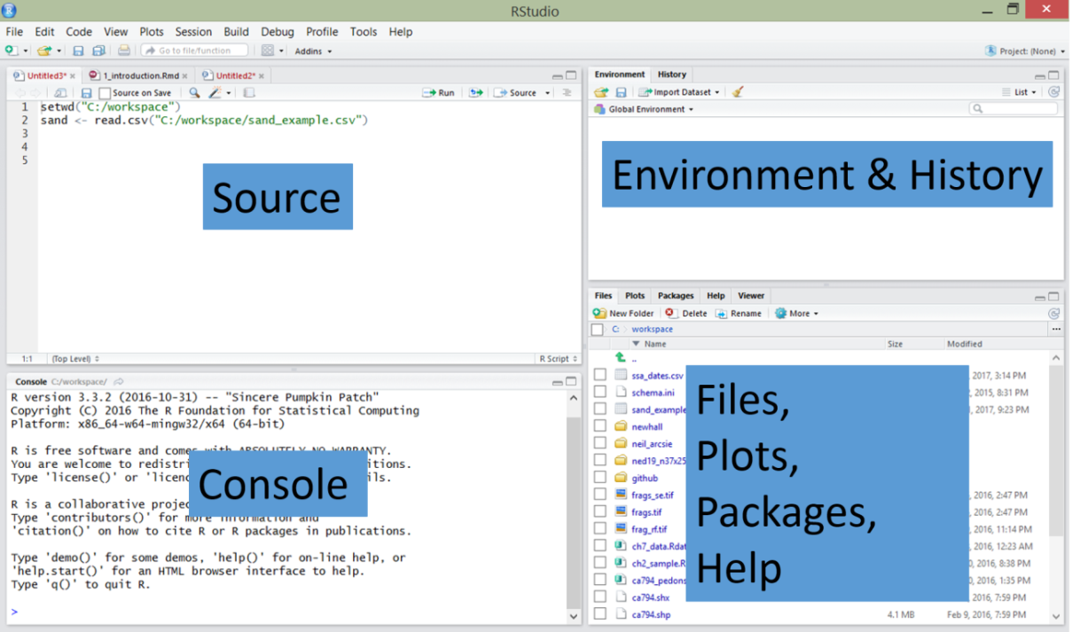
Environment of Work
R
Rstudio

Slide 5
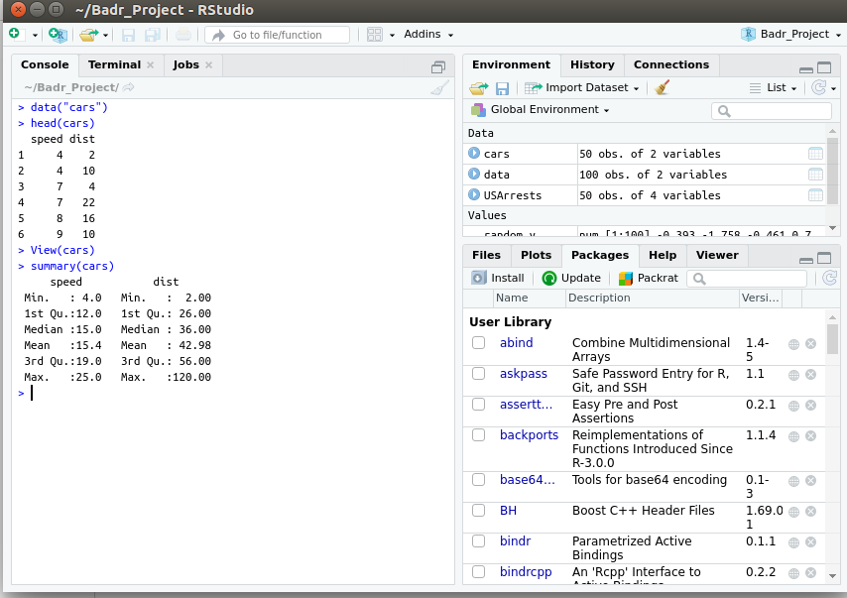
Simple Example
In this example , we have database “ Cars” . First , import database to app and view data from database . Then , summary from database and print it .

